Slide 1
Advanced Lighting

Slide 2
Advanced Lighting
Light Mapping
Ambient Occlusion Mapping
Radiosity
Per-Pixel Lighting
Normal Mapping

Slide 3
Light Mapping

Slide 4
Light Mapping
Common, widely used technique
Pre-calculated lighting stored as texture(s)
Can greatly reduce the number of lighting calculations done at run-time
Allows us to implement some lighting techniques that aren’t feasible to do in real-time
Ray tracing
Radiosity

Slide 5
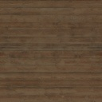


Light Mapping
Lighting information is pre-calculated using whatever algorithm we desire, limited only by
How long are we willing to wait for it to complete?
Pre-calculated lighting is view independent
No specular highlights
Lightmap is combined with surface texture at run-time to display our pre-calculated lighting
*
=
Surface
Texture
Lightmap
Visible
Result

Slide 6
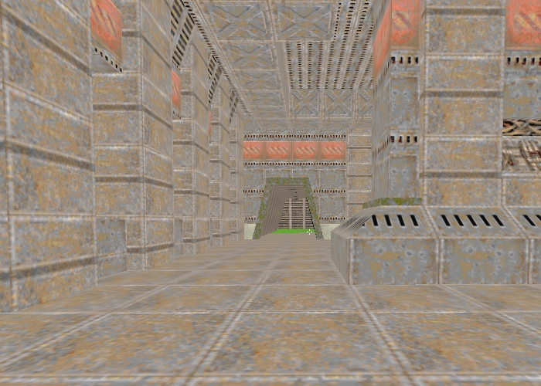
Light Mapping
Level from Quake II – Texture only

Slide 7
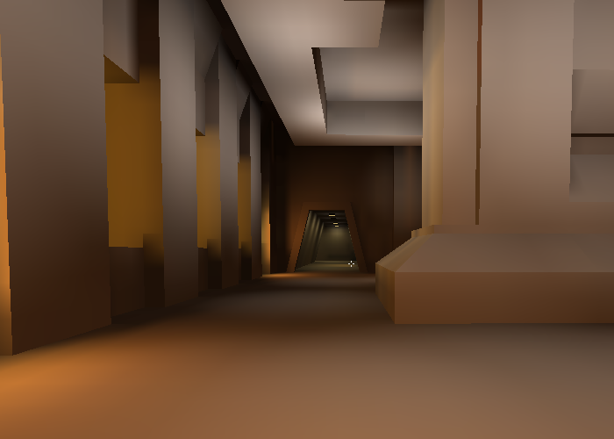
Light Mapping
Level from Quake II – Light Map only

Slide 8
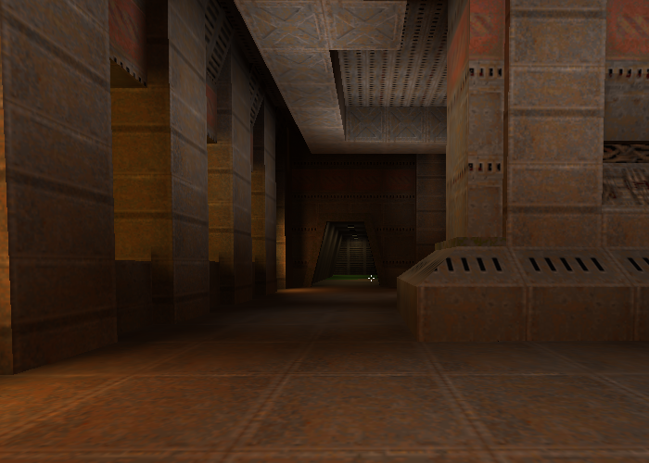
Light Mapping
Level from Quake II – Light Map * Texture

Slide 9
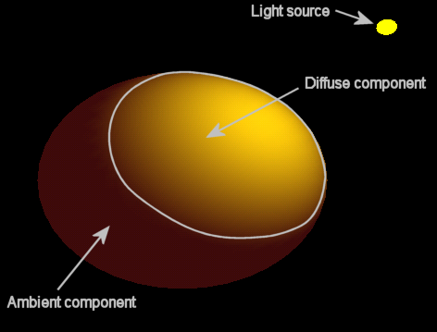
Ambient Occlusion Mapping

Slide 10
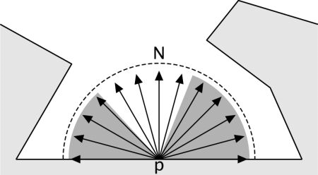
Ambient Occlusion Mapping
Method to pre-calculate how much ambient light should be able to reach different parts of a model
Self-shadowing
Surface is broken up into points (verts/texels)
A hemisphere of rays is cast from each point
If the ray intersects the mesh, the point becomes darker
If the ray does not intersect, the point becomes lighter

Slide 11
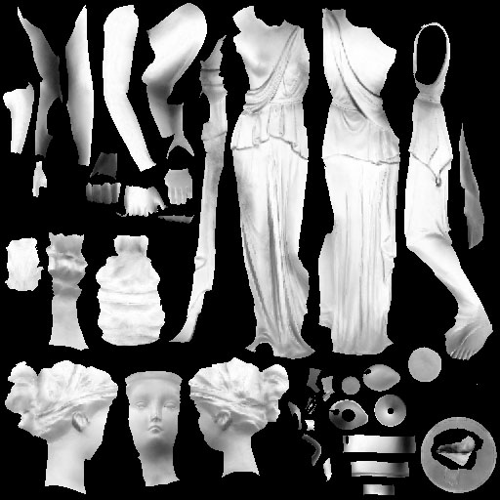
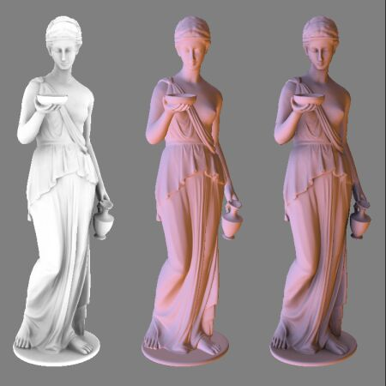
Ambient Occlusion Mapping
Occlusion information is most often stored as a texture (similar to lightmap)
AO map is combined with other lighting techniques at run-time for best results
AO Map * Ambient Lighting + Diffuse + Specular = Final Result
AO Map | Standard Lighting | Lit w/ Ambient * AO Map

Slide 12
Radiosity

Slide 13
Radiosity
What is radiosity?
Global illumination method
Full or partial replacement for ambient and diffuse lighting
Used often with indoor environments
Benefits from BSP potential visibility sets (PVS)
Simulates the transference of energy among surfaces
Slow and expensive
Pre-calculated lighting, done at time of export/building

Slide 14
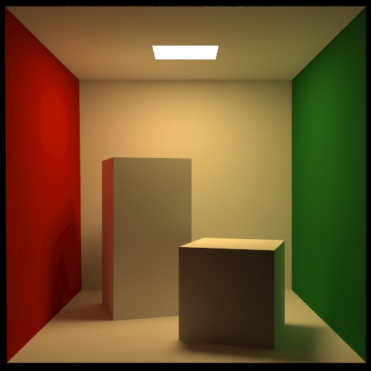
Radiosity
You’ve seen it before even if you didn’t know it

Slide 15
Radiosity
Pros
Creates rich, believable scenes
Pre-calculated
Less time is spent on lighting equations each frame
Shadowing as a natural byproduct
Cons
Pre-calculated
Lighting is fixed and generally can’t be turned off
Only for static objects
Slow and expensive to calculate
Will add significantly to level export/building times

Slide 16
Radiosity
As a replacement for ambient lighting
Ambient lighting provides some base amount of light/color to an object
Regardless of object orientation relative to light source
Ambient component per light
Global ambient illumination
Prevents our scene from appearing unnaturally stark

Slide 17
Radiosity
So why replace ambient lighting?
There is no base amount of lighting in real life
Indirect lighting in real life is caused by light being reflected and scattered
This reflection and scattering is what radiosity aims to simulate

Slide 18
Radiosity
The basic idea
Certain surfaces initially distribute light/energy
Examples
Lava
Radioactive slime pits
Overhead florescent lights
Light is distributed to other surfaces in line-of-sight
“Shooting”
Light is attenuated by various factors
These lit surfaces then become light sources themselves and the process repeats

Slide 19

Radiosity
LAVA

Slide 20
Radiosity
LAVA

Slide 21
Radiosity
LAVA

Slide 22
Radiosity
LAVA

Slide 23
Radiosity
Surfaces are often broken up into “patches”
Serve as higher resolution representation of surface
A finite number of points on the surface used for LOS checks and energy storage and distribution
16 | 17 | 18 | 19 | 20 | 21 | 22 | 23 | 24 | 25
0
1
2
3
4
5
6
7
8
9
10
11
12
13
14
15
26 | 27 | 28 | 29 | 30 | 31 | 32 | 33 | 34 | 35

Slide 24
Radiosity
Surfaces are often broken up into “patches”
Serve as higher resolution representation of surface
A finite number of points on the surface used for LOS checks and energy storage and distribution
16 | 17 | 18 | 19 | 20 | 21 | 22 | 23 | 24 | 25
0
1
2
3
4
5
6
7
8
9
10
11
12
13
14
15
26 | 27 | 28 | 29 | 30 | 31 | 32 | 33 | 34 | 35

Slide 25
Radiosity
Surfaces are often broken up into “patches”
Serve as higher resolution representation of surface
A finite number of points on the surface used for LOS checks and energy storage and distribution
16 | 17 | 18 | 19 | 20 | 21 | 22 | 23 | 24 | 25
0
1
2
3
4
5
6
7
8
9
10
11
12
13
14
15
26 | 27 | 28 | 29 | 30 | 31 | 32 | 33 | 34 | 35

Slide 26
Radiosity
Surfaces are often broken up into “patches”
Serve as higher resolution representation of surface
A finite number of points on the surface used for LOS checks and energy storage and distribution
16 | 17 | 18 | 19 | 20 | 21 | 22 | 23 | 24 | 25
0
1
2
3
4
5
6
7
8
9
10
11
12
13
14
15
26 | 27 | 28 | 29 | 30 | 31 | 32 | 33 | 34 | 35

Slide 27
Radiosity
Energy redistribution
Energy is continually redistributed iteratively
Always starts with patch with highest energy to send
Iteration stops when highest energy in a patch reaches some preset minimum
16 | 17 | 18 | 19 | 20 | 21 | 22 | 23 | 24 | 25
0
1
2
3
4
5
6
7
8
9
10
11
12
13
14
15
26 | 27 | 28 | 29 | 30 | 31 | 32 | 33 | 34 | 35

Slide 28
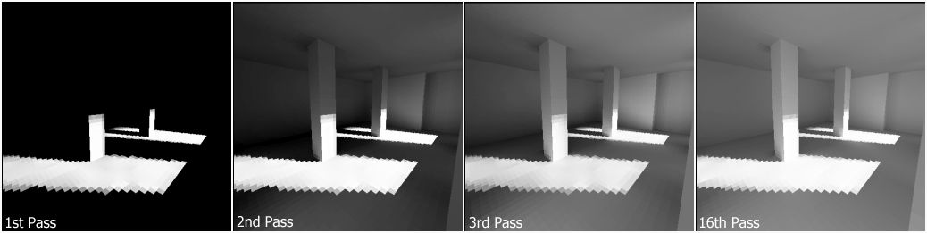
Radiosity

Slide 29
Radiosity
Lightmaps
Most common method of patch storage
Each texel in a lightmap texture represents a patch
Lightmap is combined with surface texture at run-time to display our pre-calculated lighting
*
=
Surface
Texture
Lightmap
From
Radiosity
Visible
Result

Slide 30
Radiosity
Sending Energy from one patch to another
Bi = Bi + Bj * Fij * Ai / Aj
Bi = Level of energy of patch i
Bj = Level of energy of patch j
Fij = Form factor between patch i and patch j
Ai = Area of patch i
Aj = Area of patch j

Slide 31
Radiosity
Form Factor Calculation
Fij = (cos өi * cos өj) / d² * Hij
өi, өj = Angle between normal of patch and ray between patches i,j
d = Distance between patches i,j
Hij = Visibility between patches i,j
LOS check passed? 1
LOS check failed? 0

Slide 32
Radiosity
Form Factor Calculation
Fij = (cos өi * cos өj) / d² * Hij
өi, өj = Angle between normal of patch and ray between patches i,j
Patch j
өj
өi
Patch i

Slide 33
Radiosity
Benefits from using BSP PVS
Radiosity calculations will need to be done many times from every patch to every other patch
Number of calculations and LOS checks adds up quickly
BSP PVS can help to greatly reduce the number of patches that any patch needs to “shoot” to
Determine which sector the current patch is in
Only shoot to patches that are in sectors that are in this sector’s PVS
Notes:
Potential Visibility Set

Slide 34
Per-Pixel Lighting

Slide 35
Per-Pixel Lighting
Directional Lighting Review (Diffuse Term)
I_{o} = L_{d} * M_{d} * (L_{v} ● N)
I_{o} – Intensity
L_{d} – Light’s diffuse color
M_{d} – Material’s diffuse component
L_{v} – Light vector
N – Normal
N
L_{v}

Slide 36
Per-Pixel Lighting
Directional Lighting Review (Ambient Term)
I_{a} = G_{a} * M_{a} + L_{a} * M_{a}
I_{a} – Ambient Intensity
G_{a} – Global Ambient Color
M_{a} – Material’s Ambient Component
L_{a} – Light’s Ambient Color

Slide 37
Per-Pixel Lighting
Directional Lighting Review (Specular)
Specular Color = (N ● H)^{S} * L_{s} * M_{s}
N = Normal
H (Half-Vector) = Eye - L
Eye = Vector from Vertex to Eye/Camera
Approximate reflected L vector
(N ● H)^{S} = Shininess (1-128)
L_{s} = Light’s Specular Color/Intensity
M_{s} = Material’s Specular Component
N
H
L
Eye

Slide 38
Per-Pixel Lighting
Directional Lighting Review
Combining Terms
Diffuse Term
I_{o} = L_{d} * M_{d} * (L_{v} ● N)
Ambient Term
I_{a} = G_{a} * M_{a} + L_{a} * M_{a}
Specular Color = SpecLightIntensity * (N ● H)^{S} * L_{s} * M_{s}
Color = I_{a}
If ( N ● L_{v} > 0 )
Color += I_{o} + Specular Color

Slide 39
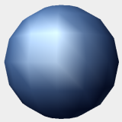
Per-Pixel Lighting
Directional Lighting Review
Per-Vertex
Lighting/Color is calculated for each vertex
Lighting/Color is then interpolated across the polygon
Interpolation is handled by graphics hardware
Results look better with more vertices/polygons
Lighting may accentuate polygons
Specular highlights may look jumpy and unrealistic
Interpolation

Slide 40
Per-Pixel Lighting
Directional Lighting
Per-Pixel
Calculates lighting for each pixel/fragment
Done through vertex and fragment shaders
Results in smoother, more believable lighting
Greatly improves the effect of specular lighting
Instead of interpolating colors, interpolates the various vectors involved in the lighting equations. These interpolated vectors are then used for lighting at each pixel/fragment

Slide 41
Per-Pixel Lighting
Directional Lighting (Per-Pixel)
Vertex Shader
Vertex Shader will calculate certain values per-vertex
These values are then interpolated by the hardware for all rendered points between vertices
Normal = WorldMatrix * float4( VertexNormal, 0 )
HalfVector = normalize(HalfVector)
Diffuse = L_{d} * M_{d} (Light’s and Material’s diffuse)
Ambient = G_{a} * M_{a} + L_{a} * M_{a}
Diffuse and Ambient colors do not need to be computed and passed if there is no material color, don’t confuse this with diffuse texture
Notes:
If you are passing the position for some other reason, fairly common, it is probably better to compute the halfVector in pixel shader.

Slide 42
Per Pixel Lighting
Interpolation Example (Normals)
Fragment F is a point on the triangle defined by vertices V0, V1, V2 with normals N1, N2, N3.
To light this fragment we need the interpolated normal for it
N0
N2
V0
F
V2
V1
N1

Slide 43
Per Pixel Lighting
Interpolation Example (Normals)
F is on the edge between V0 and V2, so it’s normal is found by interpolating only N0 and N2
F is halfway between V0 and V2, so its normal is half of N0 and half of N2
N0
N2
V0
F
V2
V1
N1

Slide 44
Per Pixel Lighting
Interpolation Example (Normals)
F is on the edge between V0 and V2, so it’s normal is found by interpolating only N0 and N2
F is halfway between V0 and V2, so its normal is half of N0 and half of N2
N0
N2
NF
V0
F
V2
V1
NF = (N0 * 0.5) + (N2 * 0.5)
N1

Slide 45
Per Pixel Lighting
Interpolation Example (Normals)
Similarly, the fragment on the same edge that is three times further from V2 than V0 receives a proportionally higher contribution from V0
N0
N2
NF
V0
F
V2
V1
NF = (N0 * 0.75) + (N2 * 0.25)
N1

Slide 46
Per Pixel Lighting
Interpolation Example (Normals)
The fragment at the center of the triangle would receive equal contributions from all three normals
N0
N2
NF
V0
V2
F
V1
N1
NF = (N0 * ~0.333) + (N1 * ~0.333) + (N2 * ~0.333)

Slide 47
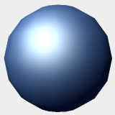
Per-Pixel Lighting
Directional Lighting (Per-Pixel)
Fragment/Pixel Shader
Fragment Shader will receive interpolated versions of the vectors previously calculated in vertex shader
Lighting is then performed using these interpolated vectors
Color = Ambient (Ambient is always present for directional light)
N = Normalize(Normal)
Normal has been interpolated, so normalize
NdotL = dot( N, -Light Direction )
If( NdotL > 0.0 )
Color += Diffuse * NdotL
H = Normalize( HalfVector)
NdotHV = saturate( dot( N, H) )
Color += (NdotHV)^{S} * L_{s} * M_{s}
Fragment Color = Color

Slide 48
Per-Pixel Lighting
Point Lighting (Review)
Performed in mostly the same manner as directional
Differences
Light direction will vary per vertex instead of constant
And later will be interpolated to vary per fragment
Point lights may attenuate
Lighting may dim and drop off the further the vertex is from the light’s position
Constant, Linear, and Quadratic Attenuation

Slide 49
Per-Pixel Lighting
Point Lighting (Per-Pixel)
Vertex Shader
Same as with directional lights, but with some minor changes and additions
Light Direction varies per vertex/pixel
Light Direction = normalize(Light Position – VertexPosition)
Or pass position to pixel shader and compute there
Ambient terms must be separated because the point light’s ambient term may attenuate, but the global ambient term will not
Ambient = L_{a} * M_{a}
GlobalAmbient = G_{a} * M_{a}
We will need the distance from point light to vertex for attenuation in the fragment shader
Distance = Magnitude( Light Position – Vertex)

Slide 50
Per-Pixel Lighting
Point Lighting (Per-Pixel)
Fragment/Pixel Shader
Color = GlobalAmbient
N = Normalize(Normal)
Normal has been interpolated, so normalize
NdotL = dot( N, Light Direction )
If( NdotL > 0.0 )
Attenuation = 1.0 / ( ConstantAttenuation + LinearAttenuation * Distance + QuadraticAttenuation * Distance² )
Color += Attenuation * ( Diffuse * NdotL + Ambient )
H = Normalize( HalfVector )
NdotHV = max( dot( N, H), 0.0 )
Color += Attenuation * (NdotHV)^{S} * L_{s} * M_{s}
Fragment Color = Color

Slide 51
Normal mapping

Slide 52
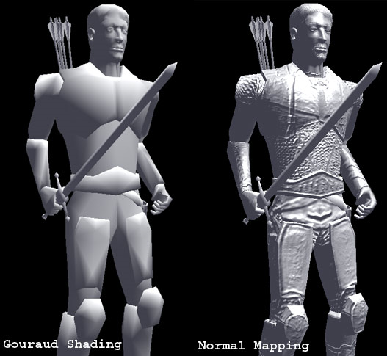
Normal Mapping
The basics
A powerful and more and more widely used method for adding detail to characters, objects, and scenes that allows us to maintain relatively low geometric complexity in our models

Slide 53
Normal Mapping
The basics
Normals are calculated from high-detail meshes, then stored in a texture (normal map) or based on diffuse texture ( Crazy Bump app)
Lower detail meshes with matching UVs are used at run-time
Normals from the normal map are used in lighting equations when rendering the lower detail mesh
Creation of normal maps is usually done by the artist through supported features of the content creation tool (Maya, 3DStudioMax, etc.)

Slide 54
Normal Mapping
The basics
Normal vectors are stored as RGB values
Red = X component, G = Y, B = Z
These values have different ranges and representations, so a direct one-to-one assignment is not possible
RGB (unsigned char * 3) = 0-255
Normal (float * 3) = -1.0f – 1.0f
Converting from normal to RGB
R = (Nx + 1.0) * 0.5 * 255.0
(Nx + 1.0) : Clamp to range (0.0 – 2.0)
(Nx + 1.0) * 0.5 : Clamp to range (0.0 – 1.0)
Perform same operation for GB/YZ components

Slide 55
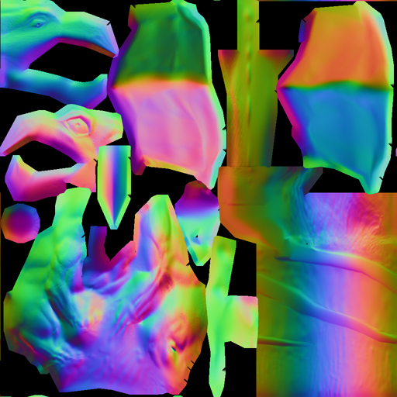
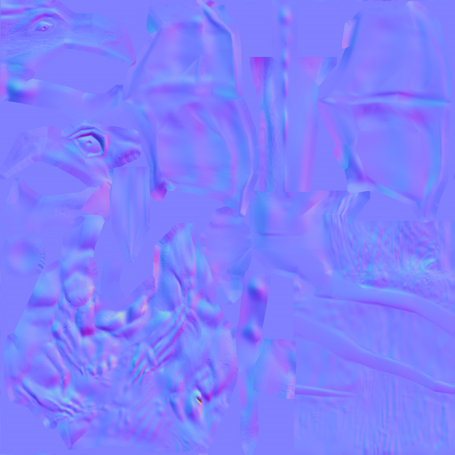
Normal Mapping
The basics
Two major types of normal maps
Object-space normal maps
Recognizable by wide range of RGB values
Tangent-space normal maps
Recognizable by being predominantly blue

Slide 56
Normal Mapping
Object-Space Normal Mapping
Simpler than tangent-space
Slightly more efficient at run-time
Straight-forward to use
In your fragment shader
Get the color from the normal map for this fragment
Convert from a color to a normal
Perform lighting equations using this normal

Slide 57
Normal Mapping
Object Space Normal Mapping
Normals are stored relative to the object, just like vertex normals
(0,1,0)
LightV
(-1,0,0)
(1,0,0)
(0,-1,0)

Slide 58
Normal Mapping
Object Space Normal Mapping
Rotations complicate things. Our vertices rotate, but our normal information from the texture doesn’t.
Any light vector would now not be in the same space as the normals
(0,1,0)
(-1,0,0)
LightV
[R]
(1,0,0)
(0,-1,0)

Slide 59
Normal Mapping
Object Space Normal Mapping
Transforming our normals by the same rotation is generally not desirable, as any surface could have thousands of normals (one for each texel in the normal map).
(0,1,0)
(-1,0,0)
LightV
[R]
(1,0,0)
(0,-1,0)

Slide 60
Normal Mapping
Object Space Normal Mapping
Instead, we find the inverse of the rotation and apply that to our light vector.
Done per vertex
LightV’ = LightV * [R⁻¹]
(0,1,0)
(-1,0,0)
LightV
[R]
(1,0,0)
(0,-1,0)

Slide 61
Normal Mapping
Object Space Normal Mapping
Our Light Vector is now in the same space as our normals for meaningful lighting calculations
(0,1,0)
LightV’
(-1,0,0)
(1,0,0)
(0,-1,0)

Slide 62
Normal Mapping
Object Space Normal Mapping
Limitations
Does not cope well with models that deform
If the model deforms, then the orientation of any individual polygon may change and we won’t have just a uniform transformation to find the inverse of

Slide 63
Normal Mapping
Tangent-Space Normal Mapping
Requires pre-computation of more data than just the normal map
Requires a few more operations at run-time
Resolves two major limitations of Object-Space Normal Mapping
Allows for deformable meshes
Vertex morphing, skinned animation, etc.
Vertices moving independently of each other
Allows for arbitrary UV use
Re-used UVs
Mirrored UVs

Slide 64
Normal Mapping
Tangent-Space Normal Mapping
Normals are stored relative to the face, rather than the object
Most normals will be closely aligned to the face, so the map ends up as mostly blue (X=R, Y=G, Z=B)
(0,1,0)
(0,0,1)
Object Space Normals
Tangent Space Normals
(-1,0,0)
(1,0,0)
(0,0,1)
(0,0,1)
(0,-1,0)
(0,0,1)

Slide 65
Normal Mapping
Tangent-Space Normal Mapping
In Object-Space Normal Mapping we had to transform the light vectors by the inverse of the objects transformation
We then had our light vectors and normals in the same space for meaningful calculations

Slide 66
Normal Mapping
Tangent-Space Normal Mapping
With Tangent-Space, our vertices may move independently of eachother
Due to this we have to find an invertible transform for each vertex!
We transform each light vector by its vertex’s inverse transform and then interpolate the results to find the new light vector that is relative to the face

Slide 67
Normal Mapping
Tangent-Space Normal Mapping
(0,0,1)

Slide 68
Normal Mapping
Tangent-Space Normal Mapping
Luckily, calculation of these per-vertex matrices can be done on the undeformed original mesh, at the time that the model is exported
Often only two vectors of each matrix are saved and sent to the vertex shader
Normal (Z-Axis)
Tangent (Perpendicular to normal)
The third vector is recalculated at run-time to reduce the amount of data sent to the shader
Bitangent (Perpendicular to both, found with cross)

Slide 69
Normal Mapping
Tangent-Space Normal Mapping
If we were doing standard texture mapping, how could we apply this texture to the polygons to render the completed image?
Texture
Polygons

Slide 70
Normal Mapping
Tangent-Space Normal Mapping
We can simply apply the texture as usual to one half of the polygons, and then mirror the UVs to mirror the texture on the other half
(0,1)
(1,1)
(0,1)
(0,0)
(1,0)
(0,0)

Slide 71
Normal Mapping
Tangent-Space Normal Mapping
We can simply apply the texture as usual to one half of the polygons, and then mirror the UVs to mirror the texture on the other half
(0,1)
(1,1)
(0,1)
(0,0)
(1,0)
(0,0)

Slide 72
Normal Mapping
Tangent-Space Normal Mapping
This is commonly used method that works great for images, but what if our texture represents normals instead of colors?
(0,1)
(1,1)
(0,1)
(0,0)
(1,0)
(0,0)

Slide 73
Normal Mapping
Tangent-Space Normal Mapping
If the normal represented by the color at this texel is (0.707, 0.707, 0.0), what will it’s mirrored counterpart be?

Slide 74
Normal Mapping
Tangent-Space Normal Mapping
The mirrored texel is still the same color, so it also represents the same normal (0.707, 0.707, 0.0)
If we used these normals, our lighting would look backwards on half of our mesh

Slide 75
Normal Mapping
Tangent-Space Normal Mapping
What we want is to also be able to mirror the normal so that we get the proper (-0.707, 0.707, 0.0)
Once we know how to do that, we can properly transform our light vector so that it is in the same space as the normals (It’s just more efficient)

Slide 76
Normal Mapping
Tangent-Space Normal Mapping
Our UVs actually represent a coordinate system, and we can see here that for the mirrored UVs our U-Axis is flipped
(0,1)
(1,1)
(0,1)
(0,0)
(1,0)
(0,0)

Slide 77
Normal Mapping
Tangent-Space Normal Mapping
For each vertex, we will have to find its UV transform
(0,1)
(1,1)
(0,1)
U
1
0
U
-1
0
V
0
1
V
0
1
(0,0)
(1,0)
(0,0)

Slide 78
Normal Mapping
Tangent-Space Normal Mapping
If we wanted to transform each normal into the same space as the light vector, we would need to
Transform the normal by the vertex’s UV transform
This will properly mirror/rotate our normal based on UVs
Then transform the normal by the vertex transform
This will rotate our normal so that it is oriented to our polygon in object space
We can actually combine these into one transform
We will then find the inverse of this unified transform so we can transform our light vectors instead of our thousands of normals

Slide 79
Normal Mapping
Tangent-Space Normal Mapping
To calculate our unified transform, we first need to find the edge vectors starting at our current vertex
We need the Vertex edges
We also need the UV edges
Given three verts - V1 (current vertex), V2, V3
Edge2-1 = V2 – V1, UV2 – UV1
Edge3-1 = V3 – V1, UV3 – UV1
Edge2-1.xyz
Edge3-1.xyz
Edge2-1.uv
Edge3-1.uv

Slide 80
Normal Mapping
Calculating the Tangent-Space Matrix
We have
Coordinate system based on vertex positions
Coordinate system based on vertex UVs
How do we map from one to the other?
When applied to the 2D UV matrix, what transform (TB) would give us the 3x2 matrix on the left?
Edge2-1.x
Edge2-1.y
Edge2-1.z
=
Edge2-1.u
Edge2-1.v
T.x
T.y
T.z
*
Edge3-1.x
Edge3-1.y
Edge3-1.z
Edge3-1.u
Edge3-1.v
B.x
B.y
B.z
=
*
?

Slide 81
Normal Mapping
Calculating the Tangent-Space Matrix
Multiply both sides by inverse of UV matrix
Edge2-1.x
Edge2-1.y
Edge2-1.z
=
Edge2-1.u
Edge2-1.v
T.x
T.y
T.z
Edge3-1.x
Edge3-1.y
Edge3-1.z
Edge3-1.u
Edge3-1.v
B.x
B.y
B.z
T.x
T.y
T.z
B.x
B.y
B.z
=
1
(Edge2-1.u)(Edge3-1.v) – (Edge3-1.u)(Edge2-1.v)
Edge3-1.v
-Edge2-1.v
Edge2-1.x
Edge2-1.y
Edge2-1.z
-Edge3-1.u
Edge2-1.u
Edge3-1.x
Edge3-1.y
Edge3-1.z

Slide 82
Normal Mapping
Calculating the Tangent-Space Matrix
We now have a matrix to transform from tangent space to object space
We want to transform a light vector from object space to tangent space, so we must orthogonalize this matrix and find it’s inverse
T.x
T.y
T.z
= T (Tangent Vector)
B.x
B.y
B.z
= B (Bitangent Vector)
N.x
N.y
N.z
= N (Vertex Normal)

Slide 83
Normal Mapping
Calculating the Tangent-Space Matrix
Gram-Schmidt Orthogonalization
Calculate the projection of one vector on to another, then subtract the projection from the original vector
T’ = T – (N●T)N
B’ = B – (N●B)N – (T’●B)T’
T’ and B’ are now orthogonal to N and each other
Normalize T’ and B’, transpose the matrix
Most implementations only pre-calculate T’ to reduce the amount of info passed to the vertex shader. B’ can then be found by crossing T’ and N in the vertex shader.
T.x’
B.x’
N.x
T.y’
B.y’
N.y
T.z’
B.z’
N.z

Slide 84
Normal Mapping
Calculating the Tangent-Space Matrix
If we are only passing the Normal and Tangent vectors to the vertex shader then there is one more piece of information we will need
We must find the determinant of our TBN matrix, and pass that as well. This will make sure that the vector from our crossproduct will point in the right direction.
Determinant of TBN = xAxis ● (yAxis cross zAxis)
For an orthonormal matrix, will be -1 or 1
Often passed as 4th component (w) of Tangent
Bitangent = Determinant * (Normal cross Tangent)

Slide 85
Normal Mapping
A note on the inverse
Many implementations will pass the non-inverted tangent and normal vectors, then find the bitangent through cross-product
To transform a vector by a matrix we dot the vector with each column (row major)
If we inverted the matrix then we would be dotting with the values that were previously in our rows
So we can avoid the actual inverse and speed up our memory access simply by dotting with each row!

Slide 86
Normal Mapping
Vertex Shader
Same as Per-Pixel with a few additions
Calculate TBN matrix
Tangent = Vertex Tangent
Normal = Vertex Normal
Bitangent = cross( Normal, Tangent ) * Determinant
Calculate light vector
LightVector = LightPosition – Vertex
Calculate TangentSpace light vector
tbnLight.x = dotProduct( Tangent, LightVector )
tbnLight.y = dotProduct( Bitangent, LightVector )
tbnLight.z = dotProduct( Normal, LightVector )

Slide 87
Normal Mapping
Fragment Shader
Same as Per-Pixel with a few additions
Get the texel from the normal map for this fragment
Convert this color to a normal
Normalize interpolated light vector
tbnLightNorm = Normalize( tbnLight );
Normal and tbnLightNorm are in same space, perform per-pixel lighting calculations

Slide 88
Normal Mapping
We are going to do things a little different in a deferred renderer.
We need to write out all the normals to a buffer for deferred rendering
We can’t change the light direction to our tangent space so we will have to transform all the normals
This is not as terrible as it would be in a forward renderer as we will only transform normals that are in view and only the normal mapped ones.

